Slide 1
Implementation of proxy on ubuntu for blocking illegal websites
Group 2

Slide 2



OUR MEMBERS
Ahmad Farhan Ibrahim
Muhammad Zidan Satrio
Pria Adil Laksana Irawan

Slide 3
01
PROXY

Slide 4
THE DEFINITION OF PROXY
Proxy is a computer system that is devoted to accessing the internet
network by utilizing an IP address. Usually, the IP address can experience
changes when you access it because the role of the proxy itself is as a
connecting medium from one network to another.

Slide 5
02
HOW DOES A PROXY WORK?

Slide 6
HOW DOES A PROXY WORK?
Because a proxy server has its own IP address, it acts as a go-between for a computer and the internet. Your computer knows this address, and when you send a request on the internet, it is routed to the proxy, which then gets the response from the web server and forwards the data from the page to your computer’s browser.

Slide 7
03
FUNCTION OF A PROXY

Slide 8
FUNCTION OF A PROXY
The function of the proxy is as a filter, which provides protection for the local network and has the potential to experience interference from outside parties.
another proxy function is as connection sharing by relying on a gateway, so it does not limit the distance and between regions to access a site.
Lastly, the function of the proxy is as caching, which is to store the history of the sites you have visited before.

Slide 9
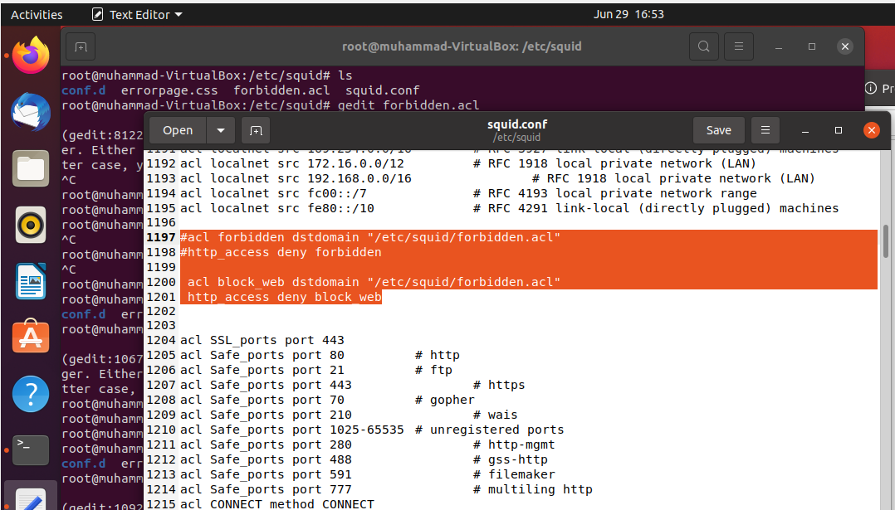
SQUID CONFIGURATION

Slide 10
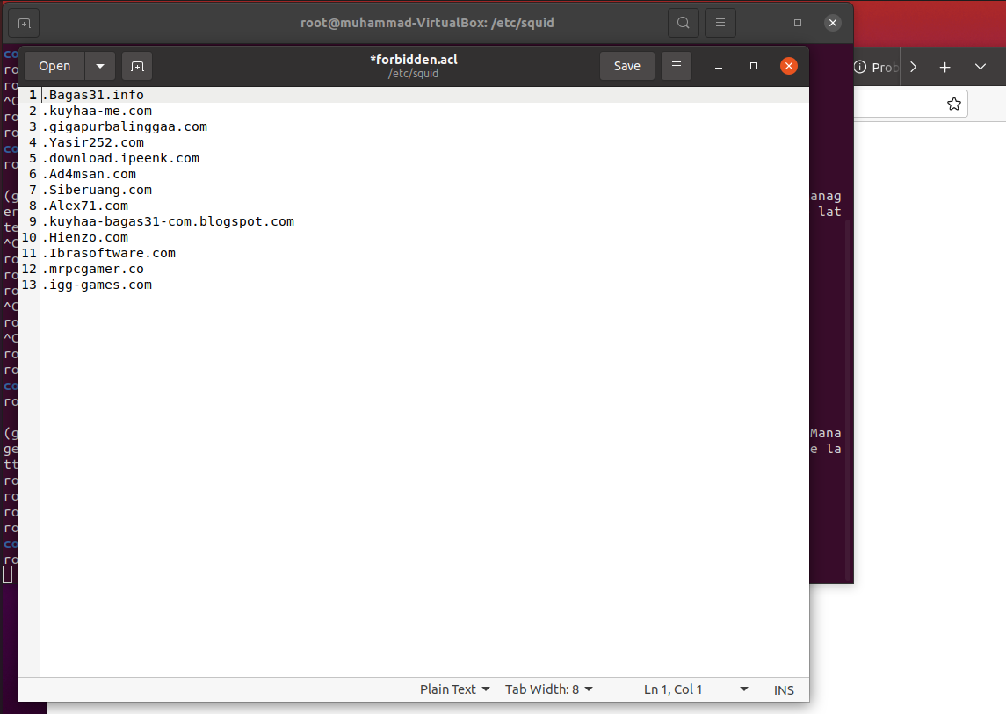
LIST ALL WEBSITES THAT WE WANT TO BLOCK

Slide 11
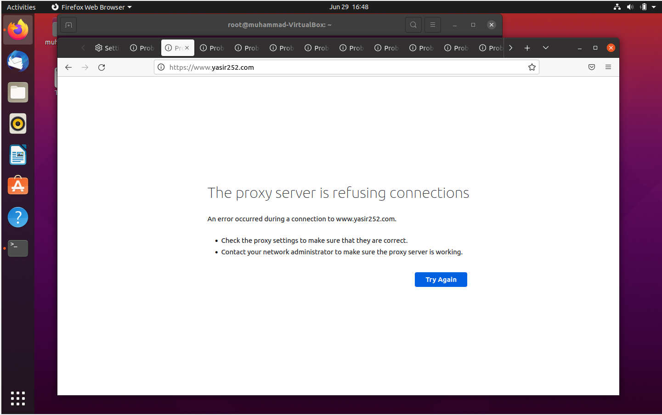
PROXY REFUSE ALL WEBSITES THAT HAVE BEEN BLOCKED

Slide 12
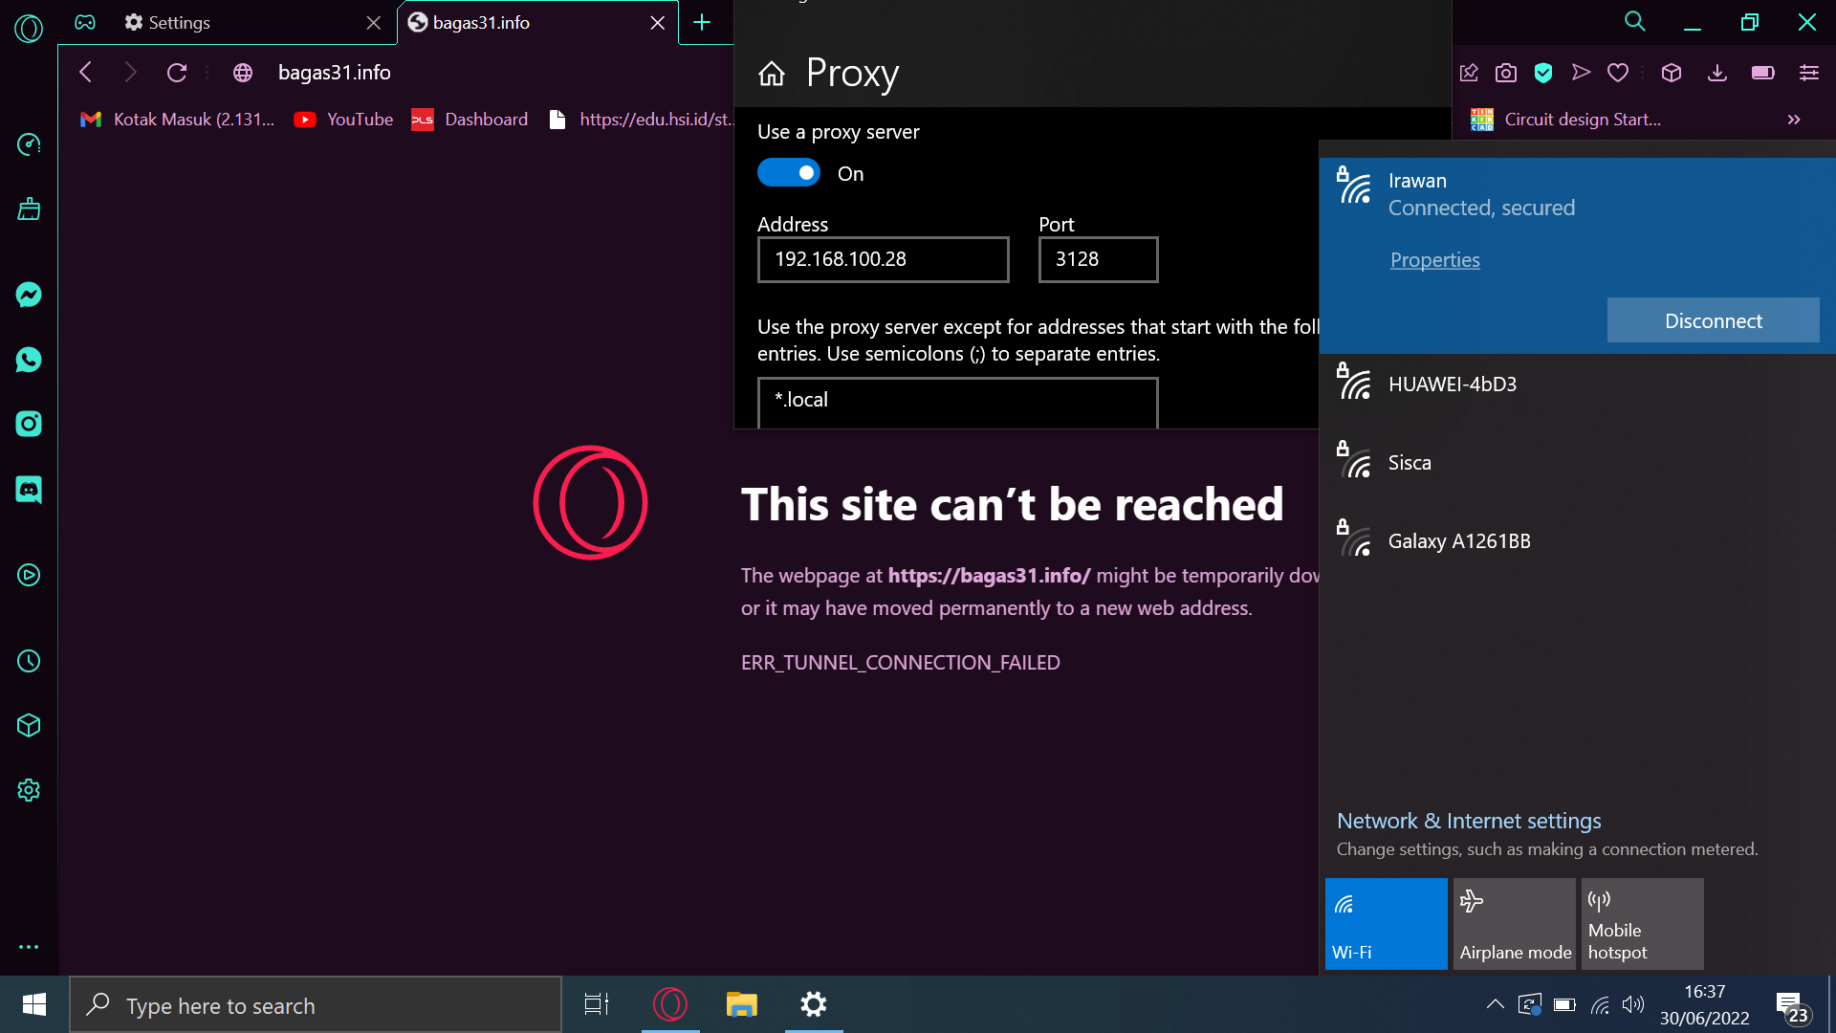
PROXY TEST IN ANOTHER NETWORK AND PC CLIENT

Slide 13
THANKS

